Slide 1


Slide 2


Slide 3
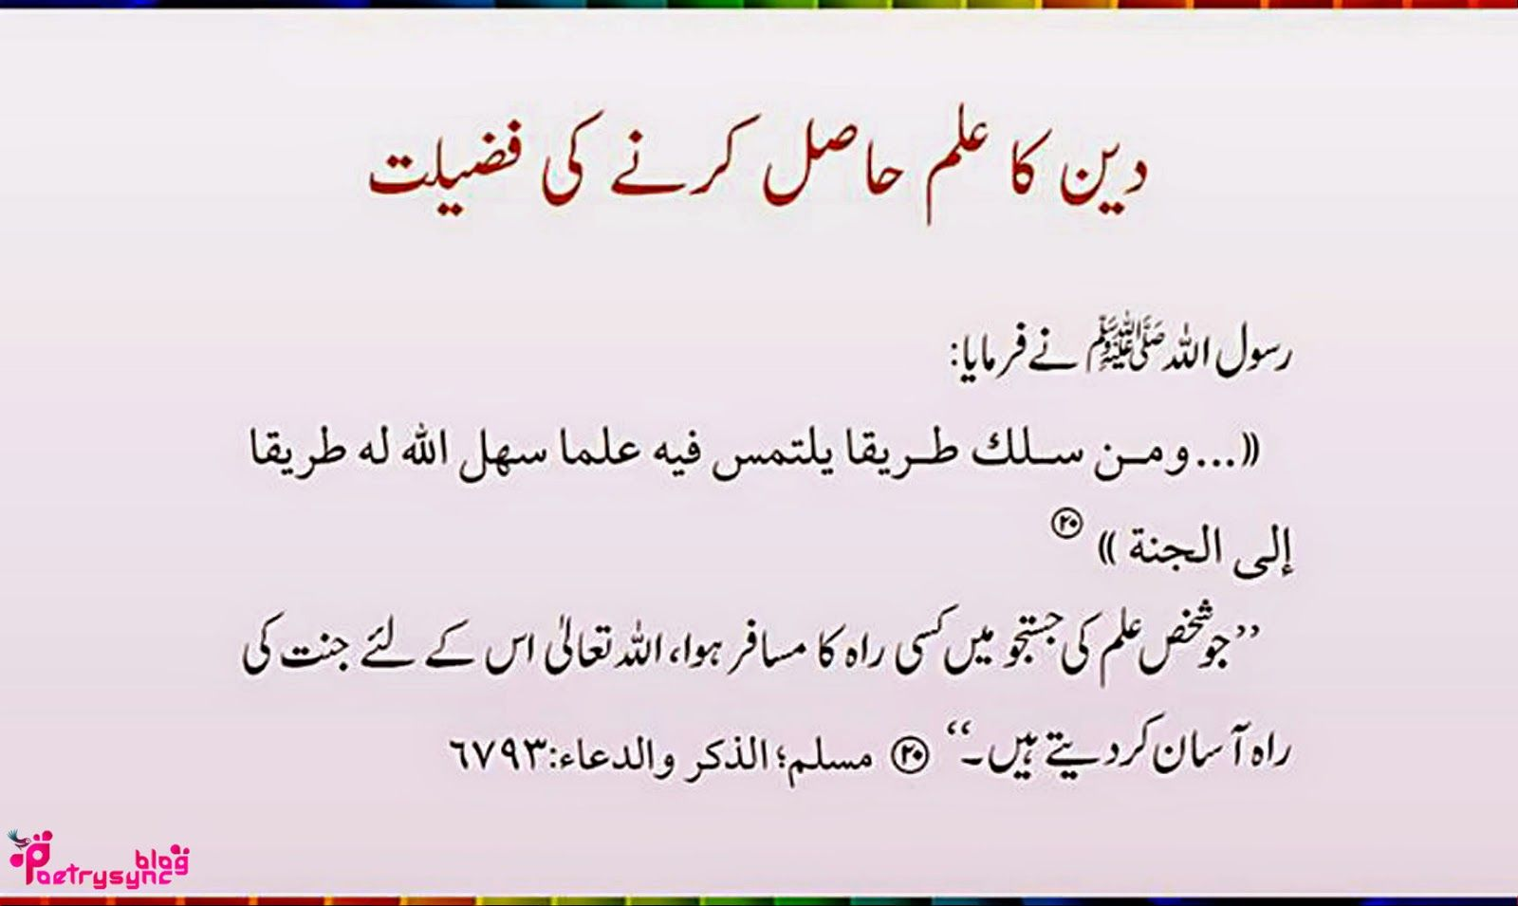

Slide 4
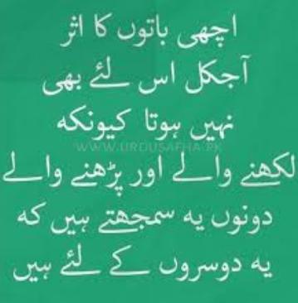

Slide 5
Outline
1: Introduction to Graphical User Interface (GUI)
1.1: Java Graphical User Interface
1.2: AWT vs Swing
1.3: Container, Frame, Panel and Dialog
1.4: GUI Components: i.e., Label, Button, TextFeild, RadioButton, TextArea, DropDown Menu
1.5: Layout Manager: Flow Layout, Border Layout, Card Layout, Grid Layout, GridBag Layout

Slide 6
Introduction to Graphical User Interface
The graphical user interface (GUI) is a form of user interface that allows users to interact with electronic devices through graphical icons and visual indicators such as secondary notation, instead of text-based user interfaces, typed command labels or text navigation.
GUIs were introduced in reaction to the perceived steep learning curve of command-line interfaces (CLIs), which require commands to be typed on a computer keyboard.

Slide 7
GUI in Java
Java.awt
Abstract Window ToolKit
Was used with java1.1
Java.Swing
Uses some of the classes of java.awt package
Part of Java Foundation Classes (JFC)

Slide 8
Creating a Window
Window class in java.awt
Provides no border and title bar.
JFrame class in java.swing
Provides title, border, and other facilities for a window.

Slide 9
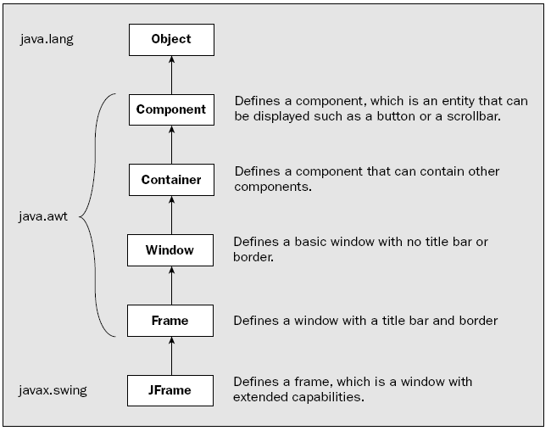
GUI

Slide 10
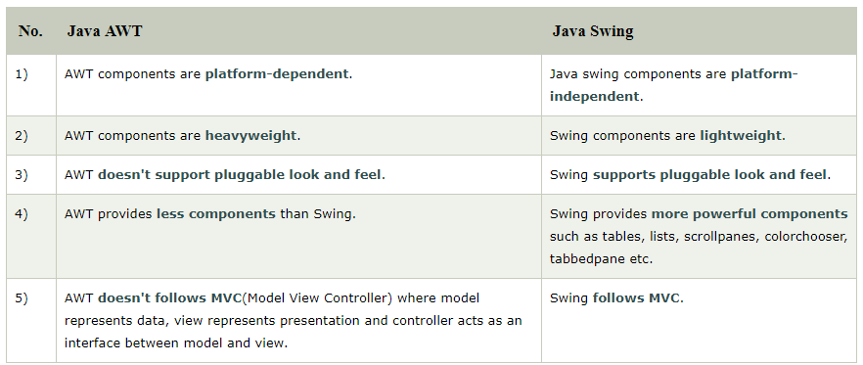
Difference between AWT and Swing

Slide 11
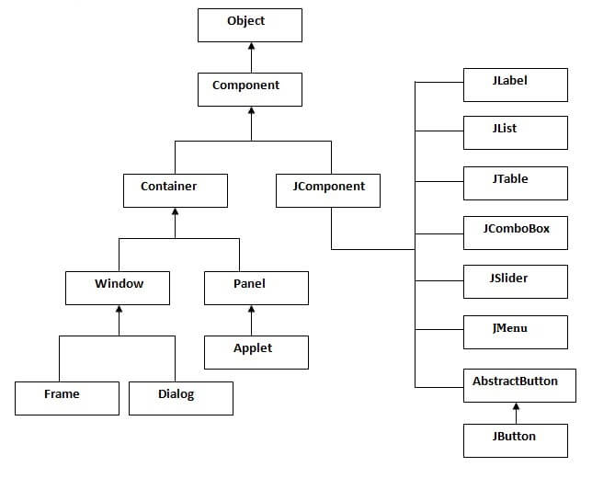
Hierarchy of Java Swing classes

Slide 12

Window Pane
Window panes are container objects that represent an area of a window.
They come in several different types.
Defined in javax.swing package

Slide 13
Component Class
Attributes
Position ( x and y with respect to the container component)
Name
Size (width and height)
Foreground color, background color
Font
Cursor
Enabled or not ( normal or grayed out)
Visible or not

Slide 14
Contd…
Methods
setName(String)
isVisible(), isEnabled() (Boolean)
setVisible(), setEnabled()

Slide 15
Changing Size and Position of a Component
Void setBounds( int x, int y, int width, int Height)
Void setBounds( Rectangle rect)
Void setSize(Dimension d)
setLocation( int x, int y)
setLocation( Point p)

Slide 16
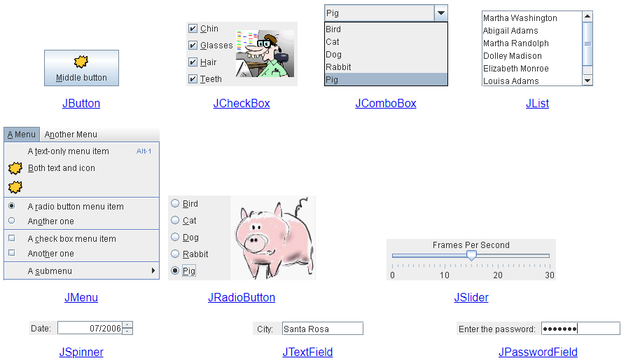
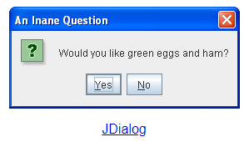
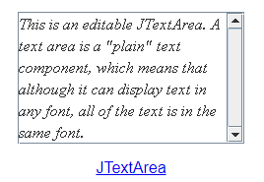
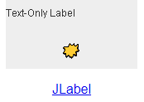
Basic Controls
http://web.mit.edu/6.005/www/sp14/psets/ps4/java-6-tutorial/components.html

Slide 17
Java Swing Examples
There are two ways to create a frame:
By creating the object of Frame class (association)
By extending Frame class (inheritance)
We can write the code of swing inside the main(), constructor or any other method.

Slide 18
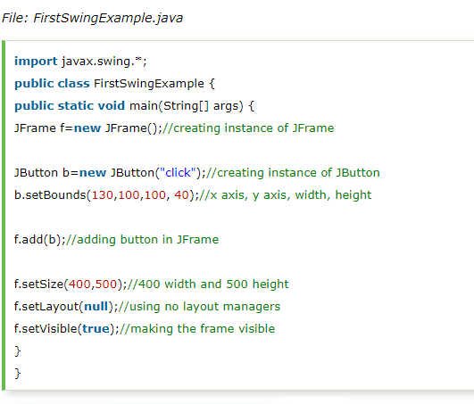
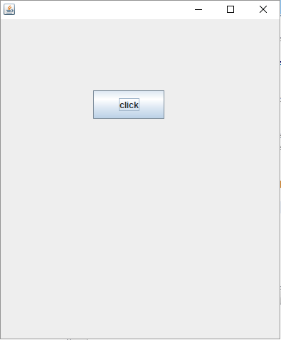
Simple Java Swing Example

Slide 19
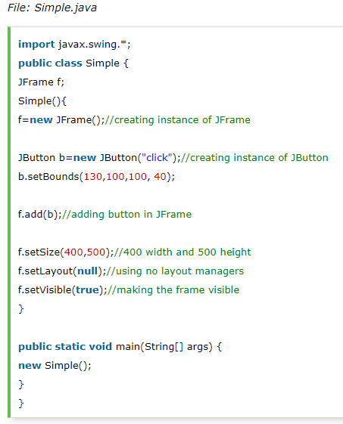
Example of Swing by Association inside constructor

Slide 20
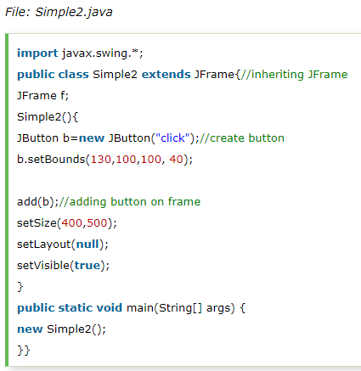
Simple example of Swing by inheritance

Slide 21
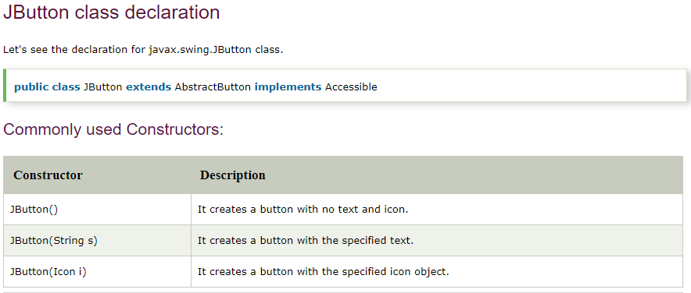
Java JButton
The JButton class is used to create a labeled button that has platform independent implementation. The application result in some action when the button is pushed. It inherits Abstract Button class.

Slide 22
Commonly Methods of Abstract Button class
Methods | Description
void setText(String s) | It is used to set specified text on button
String getText() | It is used to return the text of the button.
void setEnabled(boolean b) | It is used to enable or disable the button.
void setIcon(Icon b) | It is used to set the specified Icon on the button.
Icon getIcon() | It is used to get the Icon of the button.
void setMnemonic(int a) | It is used to set the mnemonic on the button.
void addActionListener(ActionListener a) | It is used to add the action listener to this object.

Slide 23
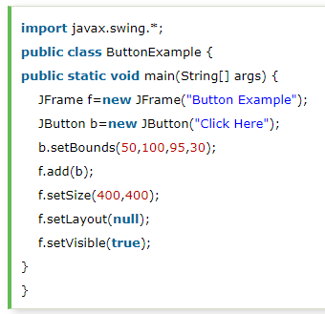
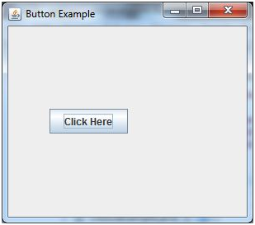
Java JButton Example

Slide 24
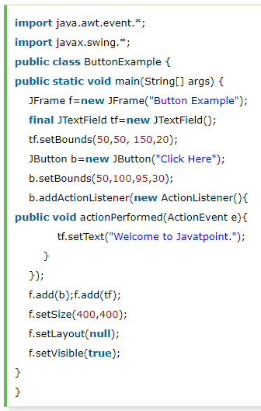
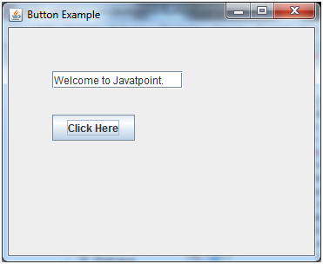
Java JButton Example with ActionListener

Slide 25
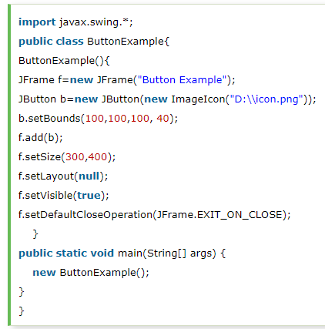
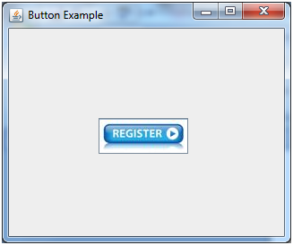
Example of displaying image on the button:

Slide 26
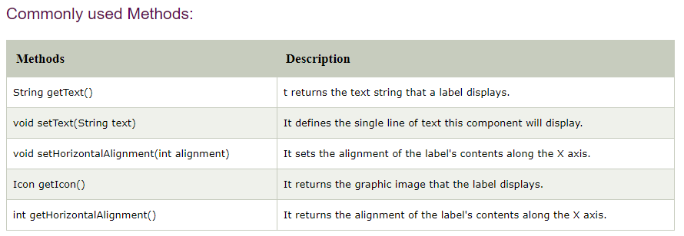
Java JLabel
The object of JLabel class is a component for placing text in a container. It is used to display a single line of read only text. The text can be changed by an application but a user cannot edit it directly. It inherits JComponent class.

Slide 27
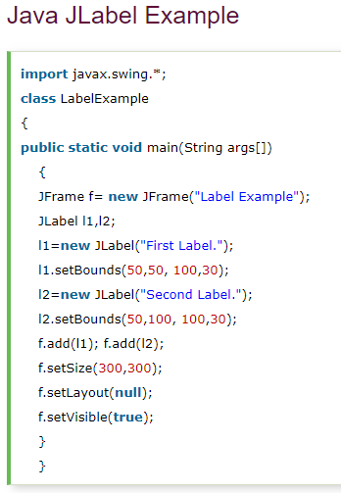
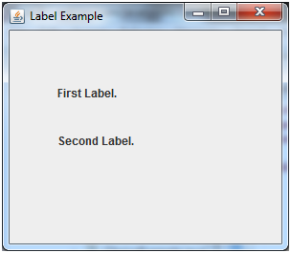
Java JLabel Example

Slide 28
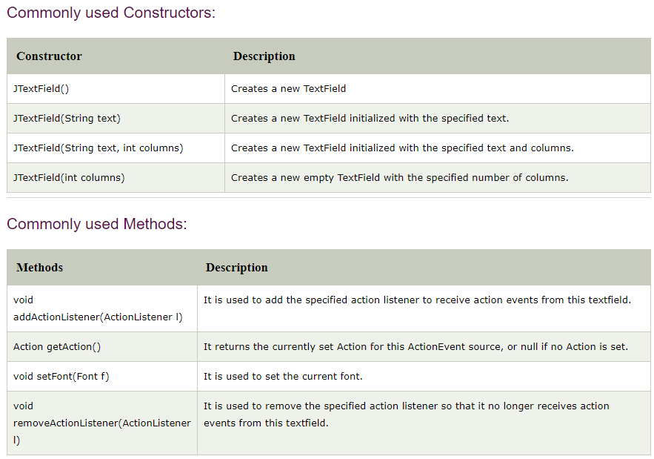
Java JTextField
The object of a JTextField class is a text component that allows the editing of a single line text. It inherits JTextComponent class.

Slide 29
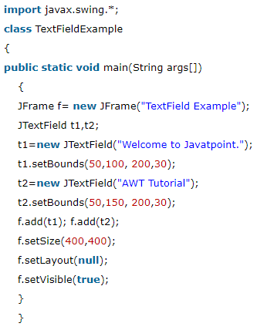
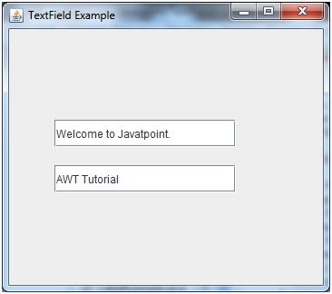
Java JTextField Example

Slide 30
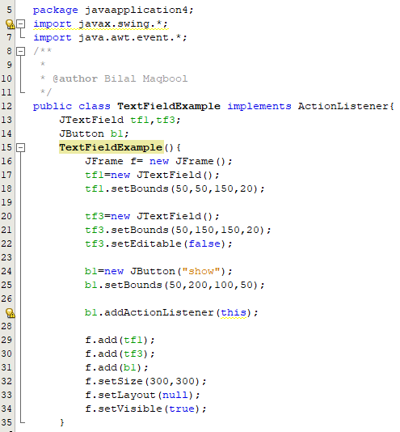
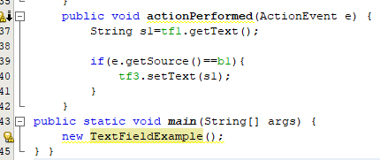
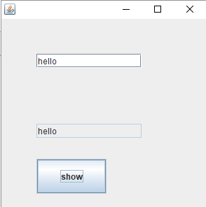
Java JTextField Example with ActionListener

Slide 31
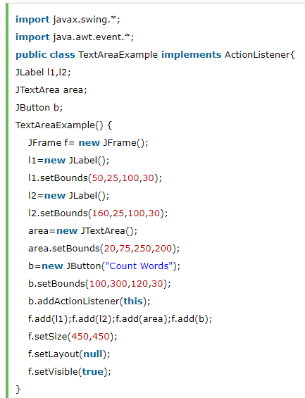
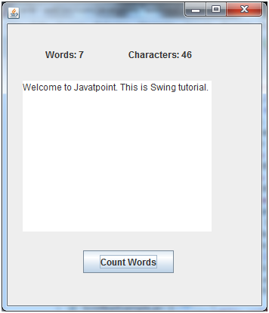
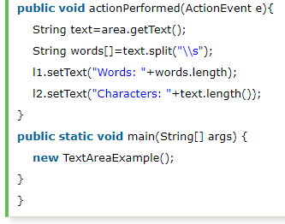
Java JTextArea Example with ActionListener

Slide 32
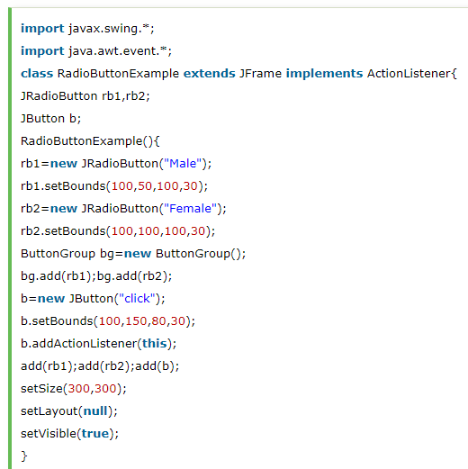
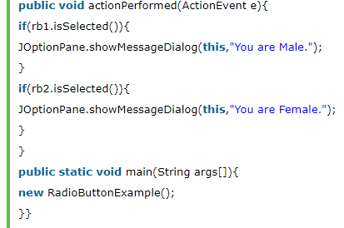
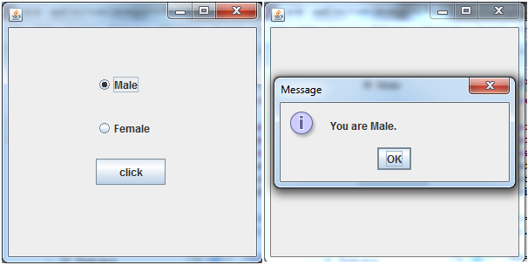
Java JRadioButton & Jdialog Example

Slide 33
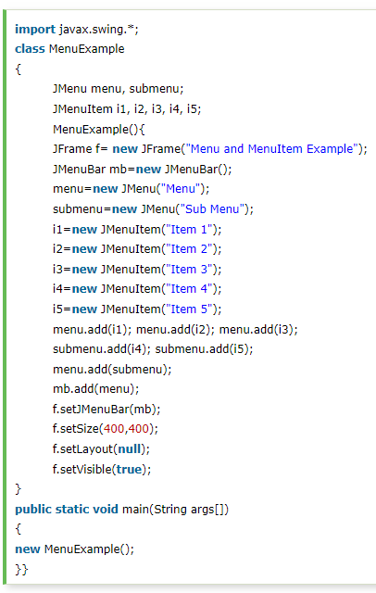
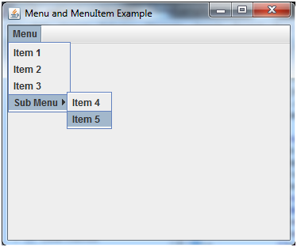
Java JMenuBar, JMenu and JMenuItem

Slide 34
Lay Out Managers
A layout manager determines the way that components are arranged in a container.
Layout manager for a container determines the position and size of all the components in the container.
The classes that define layout managers all implement the LayoutManager interface

Slide 35
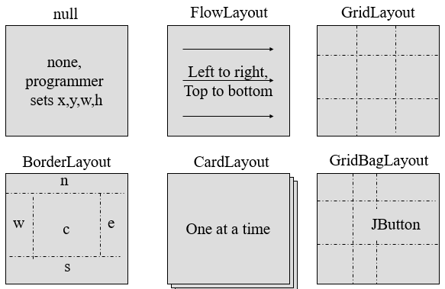
Layout Manager Heuristics

Slide 36
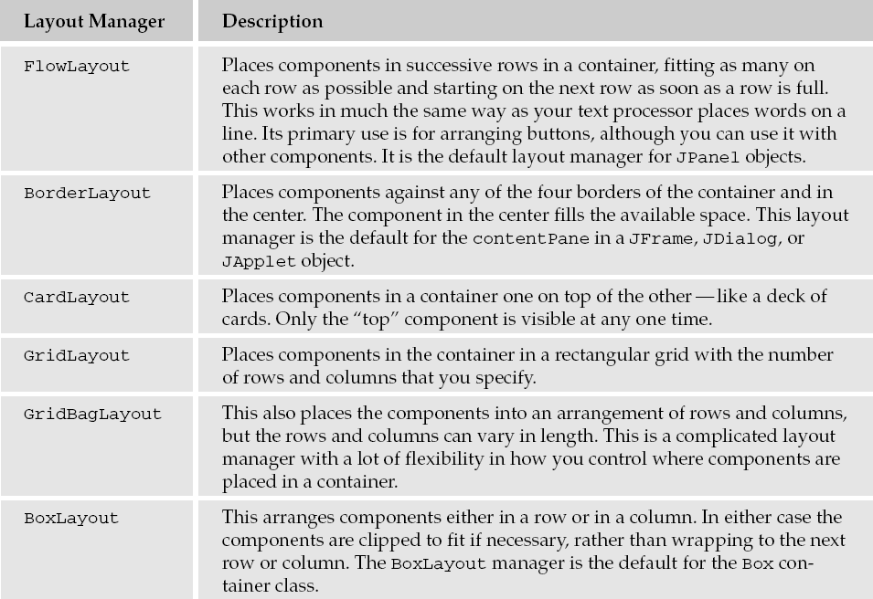
Layout Manager Heuristics

Slide 37
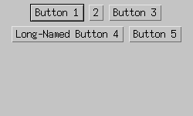
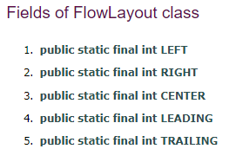
FlowLayout
It simply lays out components from left to right, starting new rows if necessary

Slide 38
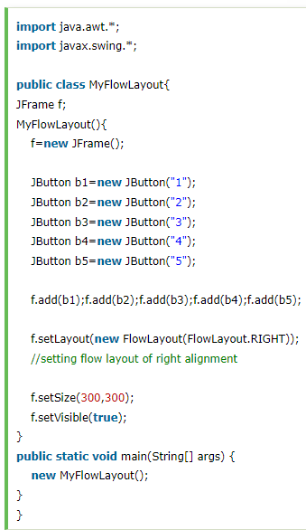
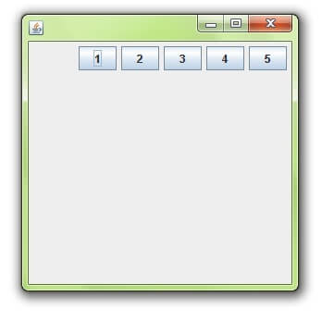
Example of FlowLayout class

Slide 39
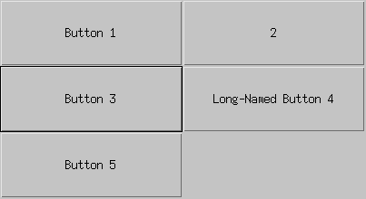

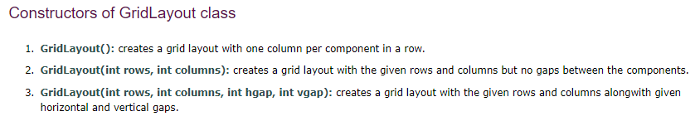
GridLayout
GridLayouts simply make a bunch of Components have equal size, displaying them in the requested number of rows and columns

Slide 40
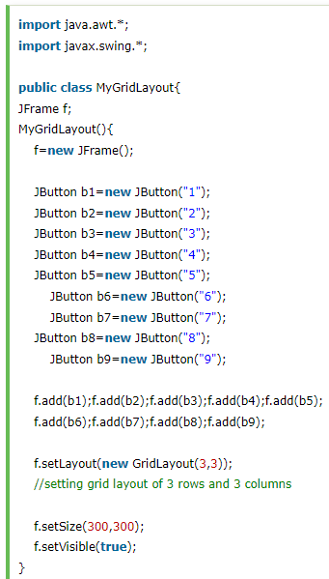
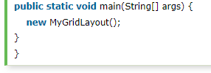
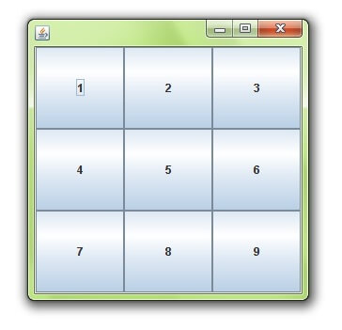
Example of GridLayout class

Slide 41
For more Study (Components & LayoutManagers)
https://www.javatpoint.com/java-swing

Slide 42
Java AWT
Java AWT (Abstract Window Toolkit) is an API to develop Graphical User Interface (GUI) or windows-based applications in Java.
Java AWT components are platform-dependent i.e. components are displayed according to the view of operating system. AWT is heavy weight i.e. its components are using the resources of underlying operating system (OS).
The java.awt pakage provides classes for AWT API such as Textfield, Label, TextArea, RadioButton, CheckBox, Choice, List etc.

Slide 43
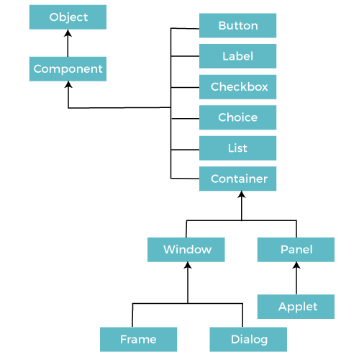
Java AWT Hierarchy

Slide 44
Java AWT
To create simple AWT example, you need a frame. There are two ways to create a GUI using Frame in AWT.
By extending Frame class (inheritance)
By creating the object of Frame class (association)

Slide 45
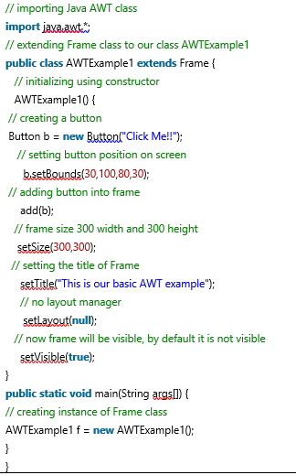
Java AWT
AWT Example by Inheritance:

Slide 46

Java AWT (Java Awt by inheritance)

Slide 47



Java AWT (Java Awt by Association)

Slide 48



Java AWT Button Example with ActionListener

Slide 49


Button Class Constructors:
Explore other methods of Buttohttps://www.javatpoint.com/java-awt-button

Slide 50


Java AWT TextField Example with ActionListener

Slide 51


Java AWT TextField Example with ActionListener

Slide 52

THANKS! ☺

